Slide 1



General Sir John Kotelawela Defence University
Smart Vehicle Parking Management System (SVPMS)
Proposal of the Final Year Individual Project
By
GGYU Gunasekara (ICT/12/0142)
Under the Supervision of
Mr. ADAI Gunasekara

Slide 2

Content
Introduction & Background
Current Practices
Application Proposal
Aim & Objectives
Scope & Constraint
Research Approach
Project Plan

Slide 3
Introduction & Background
The vehicle parking has become an enormous matter especially in urban areas
Most of the parking areas today in Sri Lanka currently operate without any computerized system
Usually require vehicle owners to walk around and manually check the occupancy of individual spots

Slide 4
Cont…
Presenting Problems
Difficulty in Finding Vacant Spaces
Improper Parking
Poor Management

Slide 5
Current Practices
Wired Sensor-based Technology
Wireless Sensor-based Technology
Image Processing and Character Recognition Technology

Slide 6
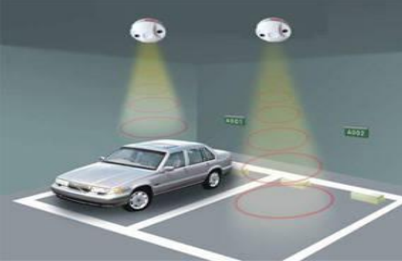
Wired Sensor-based System
Smart Parking System (SPS) Architecture Using Ultrasonic Detector
Ultrasonic sensors detect car park occupancy or improper parking actions

Slide 7
Wireless Sensor-based System
RFID-Based Automatic Vehicle Parking System
RFID technology is an automatic identification method consisting of several components such as tags, tag readers, edge servers, middleware, and application software.

Slide 8
A Street Parking System Using Wireless Sensor Networks
Monitor the state of every parking space by deploying a magnetic sensor node on the space
Each sensor node distinguishes the earth’s magnetic field periodically

Slide 9
Image Processing and Character Recognition Technology
Automatic Parking Management System and Parking Fee Collection Based on Number Plate Recognition
The system used image processing of recognizing number plates for operation of parking and billing system

Slide 10
Parallel Systems in Sri Lankan Context
World Trade Center
Magnetic sensors are deployed in the entry and exit gates
Customer gets a proximity card including a barcode number at the entry point and the system keep the record of entry time

Slide 11
Application Proposal
Recommended Solution : Infrared Sensor Technology
Main Users:
Customers
Administrative Staff
System Operators

Slide 12
Overall System Architecture

Slide 13
Functional Requirements
Module-1: User Interaction
The SVPMS shall be able to create customer profiles by filling customer details such as first name, last name, date of birth, phone number, company details etc. To log into an account, the user must be able to provide his or her username and password
User should be able to edit or delete an account.
Module-2: Parking Space Monitoring
The SVPMS shall be able to detect when and if each individual parking space is occupied (in 30 second increments) and be able to report this information to the entrance office
The SVPMS shall be able to detect when and if each individual parking space is unoccupied (in 30 second increments) and be able to report this information to the entrance office
The SVPMS shall be able to detect when and if each individual parking space is reserved (in 30 second increments) and be able to report this information to the entrance office

Slide 14
Module-3: Payments
The system shall process payments based on length of parking time
Periodically (e.g., once a month), the system examines the list of transactions for all customers and generates the monthly statement
Module-4: System Administration
The SVPMS shall be able to view the registered customers’ profiles and customer statistics
The SVPMS shall be able to set the various prices and rates for the different services provided
Module 5: Statistical Data Collection (Reporting)
The SVPMS shall be able to display and print reports of the data stored on the network based on user specified criteria
The SVPMS should be able to view various statistical charts about parking occupancy over different periods (day, week, month, etc.)

Slide 15
Non-functional Requirements
Performance requirements
Reliability
Maintainability
Safety
Security
Eco-friendly

Slide 16
Technical Requirements
The system will be developed using Microsoft Visual Studio 2012 platform using C# language.
Microsoft Windows Server 2008 will be used as the database to store the data
Wireless sensor technology and barcode technology will be used to develop the hardware implementation.
The application package would develop as it is compatible for any computer which runs on windows platform such as Windows 2000, XP, 2007 and 2008

Slide 17
Usability Requirements
Gather information about the different user access levels and how to personalize the user interfaces for each access levels.
System shall be able to provide user friendly interfaces to the users.
Design the interfaces according to gathered user requirements
System should be adopt in Microsoft web and desktop based environments
Gather requirements using various fact gathering techniques such as interviews, questionnaires, observations, document review etc. to have a broad idea about the system
If the users are not up to the standards to use the system in an effective way, system developers should conduct training sessions to develop knowledge to use the system without having any trouble

Slide 18
Aim & Objectives
Aim:
To develop an application for a shopping complex to manage vehicle parking through IR and Barcode technologies to mitigate the constraints which the customers will faced.
Objectives:
To develop an application which help customers to find a parking slot in an efficient manner
To provide accurate results with the application to the users
To provide the application with a user interactive and user friendly manner
To provide backup, recovery and data integrity features to the database
To provide authentic and authorized features to secure confidential data which can only be viewed by authorized user
To deliver error free software application to the users

Slide 19
Scope & Constraints
Scope:
From the adding user information and managing the parking spaces in the system to have daily reports will be covered by this proposed system
Constraints :
Technical Constraints
Financial Constraints
Time Constraints
Resource Constraints

Slide 20
Research Approach

Slide 21
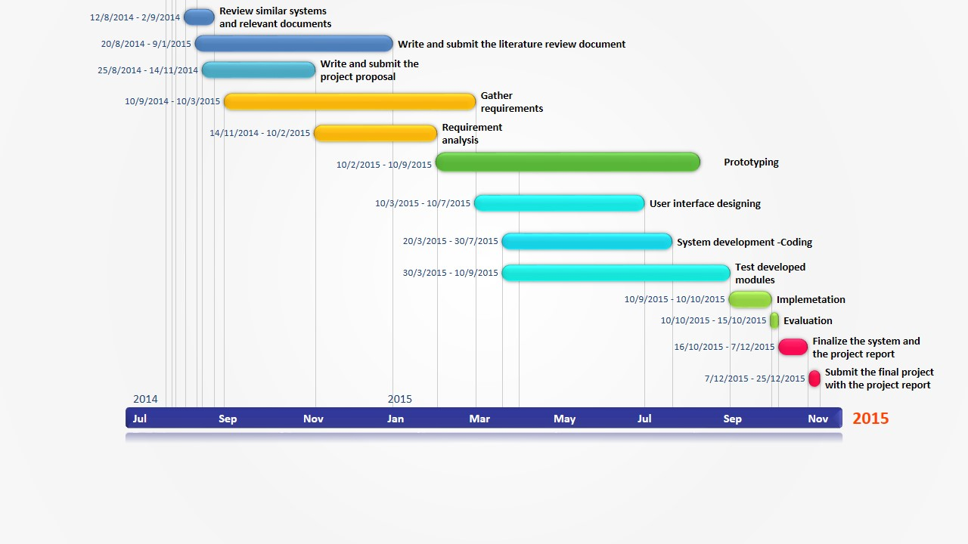
Project Plan

Slide 22
References
Fishbein, M, Ajzen, I, 1975, “Belief, Attitude, Intention and Behaviour: An Introduction to Theory and Research”
Coopers, P, 2005, “From Beijing to Budapest - Winning Brands. Winning Formats”, pp. 126
Kianpisheh, A, Mustaffa, N, Limtrairut, P, Keikhosrokiani, P, 2012, Smart Parking System (SPS) Architecture Using Ultrasonic Detector, vol.6, no.3, University Sains Malaysia.
Waraich, B, 2012, ‘RFID-Based Automatic Vehicle Parking System’, http://www.efymag.com
Khan, R, Shah, Y, Khan, Z, Ahmed, K, Manzoor M, Ali, A, 2013, Intelligent Car Parking Management System On FPGA, Vol. 10, Issue 1, no.3, Sarhad University of Science and IT, Peshawar, Pakistan, Institute of Business & Management Sciences, AU, Peshawar, Pakistan, UET, Peshawar, Pakistan

Slide 23
Zhang, Z, Li, X, Yuan, H, Yu, F, 2013, A Street Parking System Using Wireless Sensor Networks, vol.2013, Dongguan University of Technology, China http://www.hindawi.com/journals/ijdsn/2013/107975/
Rashid, M, Nusa, A, Rahman, A, Farahana, N, Farhana, A, 2012, Automatic Parking Management System and Parking Fee Collection Based on Number Plate Recognition, International Journal of Machine Learning and Computing, Vol. 2, No. 2
Kastrinaki, V, Zervakis, M, Kalaitzakis, K, 2003, A survey of video processing techniques for traffic applications. Image Vision Comput., 21: 359-381 http://www.barcodesinc.com/articles/barcode-technology.htm

Slide 24


